Slide 1
ENEL 419
Introduction to Reliability Analysis
Reading Exercises: Class Notes

Slide 2
Concept of Reliability
Reliability:
A measure of the quality of a product.
The probability of the product functioning properly for a specified period.
The ability of a product to perform a required function without failure, under stated conditions for a specified time period.
Etc.

Slide 3
Impact of Lack of Reliability
Safety can be impacted
Competitiveness can be impacted
Profit margins can be impacted
Cost of repair and maintenance can be impacted
Delays can be impacted further up supply the chain
Reputation can be impacted
Good will can be impacted

Slide 4
Steps to Achieve Reliability
Causes of failure need to be identified
Causes of failure must be addressed in the design stage
Otherwise, reliability must be designed/built into the product itself

Slide 5
Learning outcomes
Be able to
Define Failure probability distribution (PDF and CDF)
Define Reliability function and its properties
Define Failure rate function and its properties
understand the steps for deriving failure rate function
Understand the steps for deriving Mean Time to Failure (MTTF)
Evaluate reliability, failure rate and MTTF for exponential distribution
Evaluate the reliabilities of systems involving series and parallel connections

Slide 6
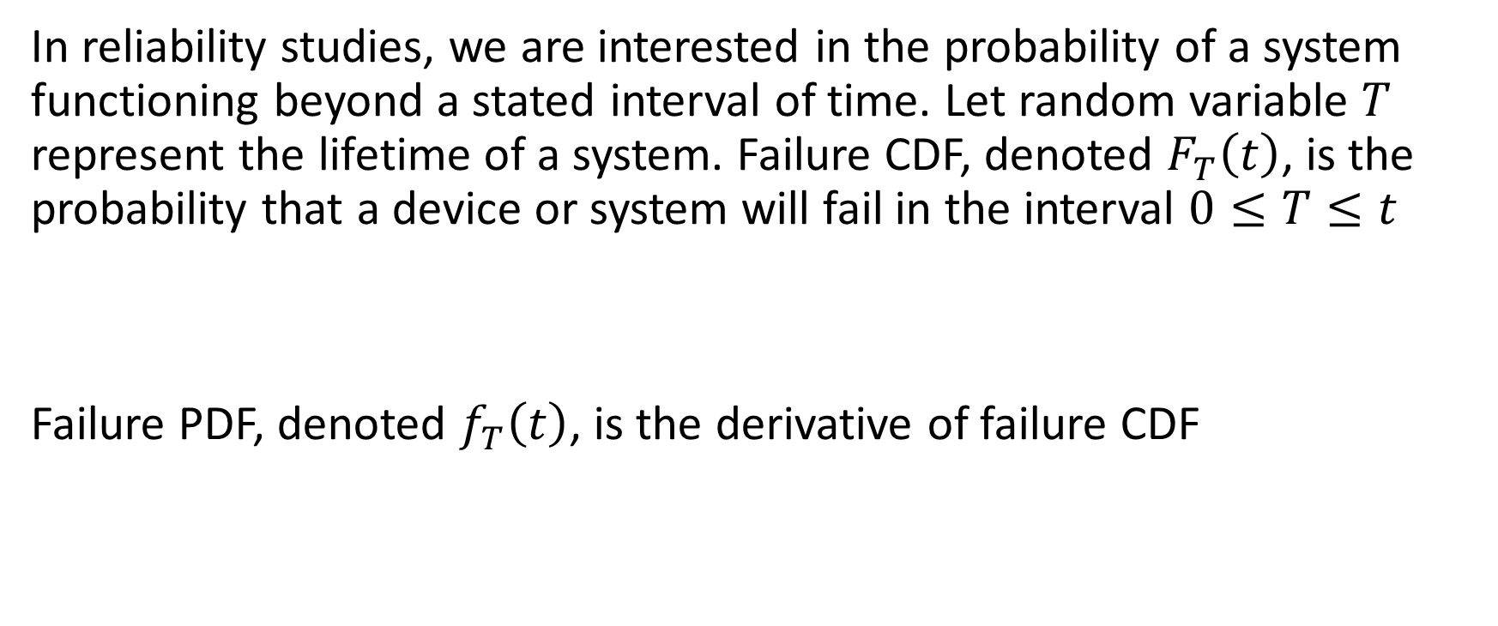
Failure CDF and Failure PDF
In reliability studies, we are interested in the probability of a system functioning beyond a stated interval of time. Let random variable $T$ represent the lifetime of a system. Failure CDF, denoted $F_{T}\left(t\right)$, is the probability that a device or system will fail in the interval $0≤T≤t$
Failure PDF, denoted $f_{T}\left(t\right)$, is the derivative of failure CDF

Slide 7

Reliability Function
The reliability function, $R_{T}\left(t\right),$ is the probability that a system will function beyond a specified time $t$. It is, therefore, the complement of the probability of failure
Reliability function is also known as survival function

Slide 8
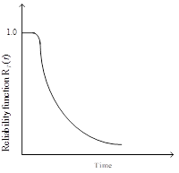

Properties of Reliability Function
$$0≤R_{T}\left(t\right)≤1$$
$$R_{T}\left(0\right)=1 \left(initial life\right)$$
$$R_{T}\left(∞\right)=0 \left(end of life\right)$$
$$R_{T}\left(t_{2}\right)<R_{T}\left(t_{1}\right) for t_{2}>t_{1}$$

Slide 9
Failure PDF in Terms of Reliability Function
Since reliability and failure probabilities are complements of each other, we have

Slide 10

Conditional probability of failure
Suppose a device functions properly prior to time $t$ but fails abruptly in the (infinitesimally small) interval $t≤T≤t+∆t$.
Define the conditional probability that the product fails in the interval $t≤T≤t+∆t$, given that it did not fail prior to time $t$,

Slide 11
Conditional probability of failure

Slide 12

Failure Rate
Failure rate, denoted, $r_{T}\left(t\right)$, is the rate at which the conditional probability of failure varies with time,

Slide 13
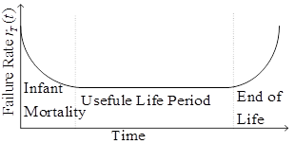
Bathtub Model for Failure Rate
The failure rate function curve is, in general, modeled by a bathtub curve, as shown below.

Slide 14
Product Life Cycle
The bathtub curve represents the failure rate of a product during its lifecycle and comprises three stages:
Early failure period (or infant mortality) – debugging period during which faults are fixed
Useful life period (constant failure rate period) – failures are rare.
Old age period - failures occur due to wear-out.

Slide 15

Mean Time to Failure
Mean time to failure, denoted $MTT$, is average time to failure (or average lifetime),
$$MTTF=E\left[T\right]=\int_{0}^{∞}{tf_{T}\left(t\right)dt}$$

Slide 16
Summary of Useful Formulas

Slide 17
Exponential Failure Distribution
The PDF, CDF, reliability function, failure rate and MTTF for an exponential failure rate are all summarized in the table below

Slide 18

Example 1
Suppose we want to measure the time it takes to run a washing machine before it fails. If the failure distribution is exponential with mean $100,000 hours$. What is the probability that the machine will fail during its first $50,000 hours$?

Slide 19
Solution

Slide 20
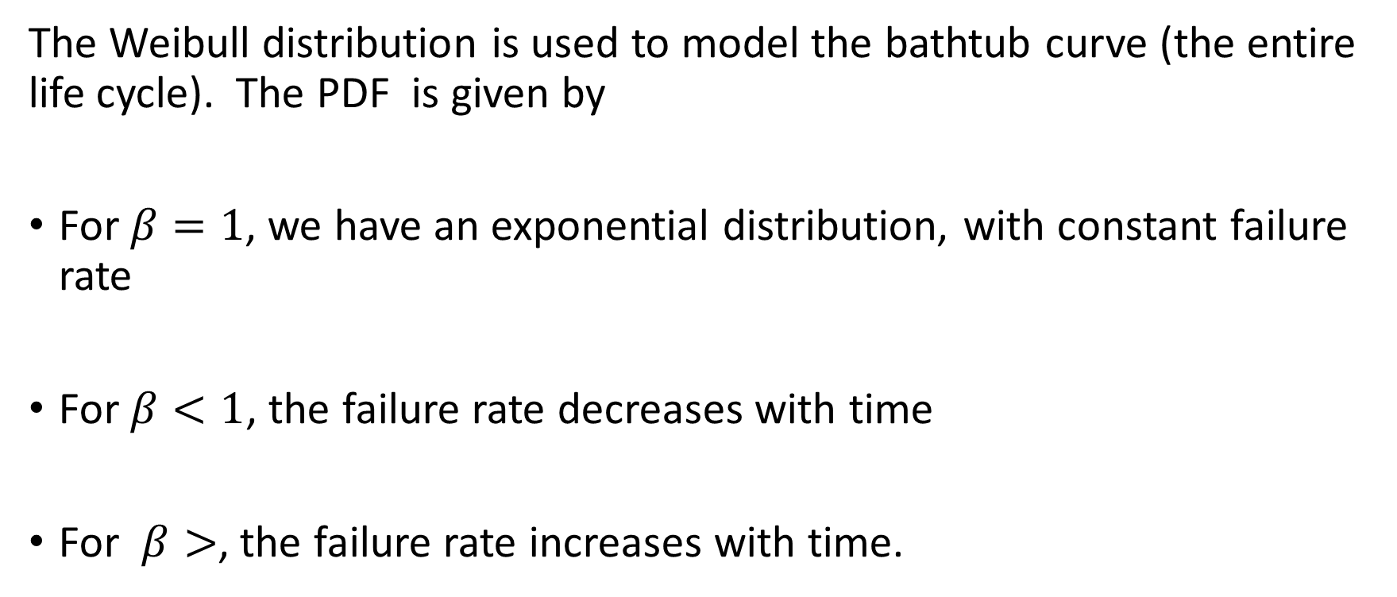
Weibull Distribution
The Weibull distribution is used to model the bathtub curve (the entire life cycle). The PDF is given by
For $β=1$, we have an exponential distribution, with constant failure rate
For $β<1$, the failure rate decreases with time
For $β>$, the failure rate increases with time.

Slide 21
Reliability of Systems
An electrical system is made up of multiple components or subunits
The reliability of a product depends on how the components or subunits are interconnected
Two basic types are series and parallel connected systems
More complex systems will comprise a combination of series and parallel connections.

Slide 22
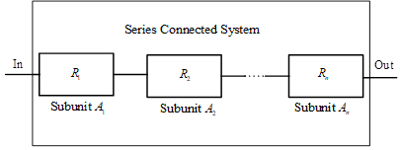

Reliability of Series Connected Systems
Consider a system of $n$ series interconnected subunits. The $i^{th}$ subunit, $A_{i}, i=1,2,…,n$, has reliability $R_{i}=P\left[A_{i} functions correctly\right]$ and all the subunits operate independently

Slide 23
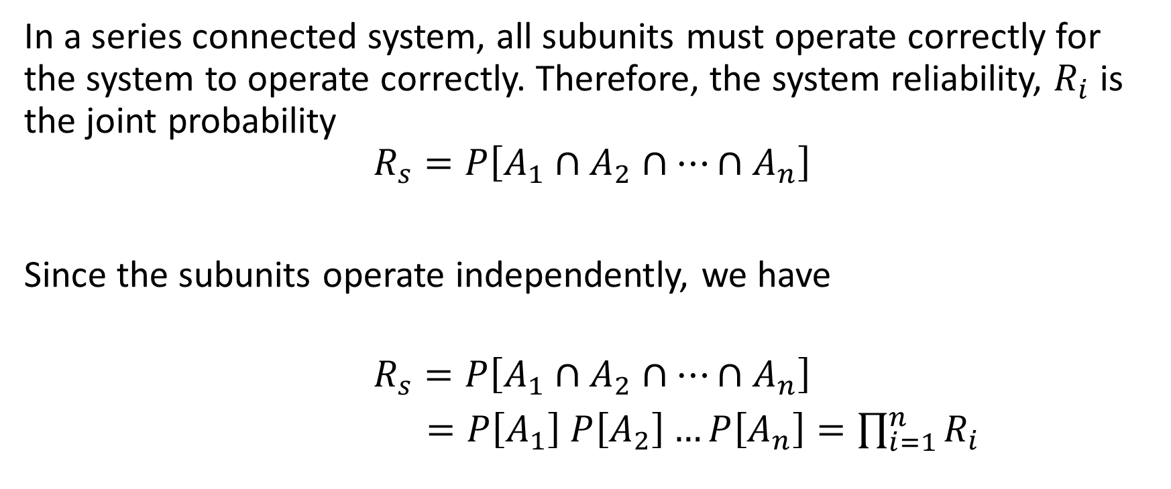
Reliability of Series Connected Systems
In a series connected system, all subunits must operate correctly for the system to operate correctly. Therefore, the system reliability, $R_{i}$ is the joint probability
$$R_{s}=P\left[A_{1}∩A_{2}∩⋯∩A_{n}\right]$$
Since the subunits operate independently, we have
$$R_{s}=P\left[A_{1}∩A_{2}∩⋯∩A_{n}\right]$$
$=P\left[A_{1}\right]$ $P\left[A_{2}\right]…P\left[A_{n}\right]=\prod_{i=1}^{n}{R_{i}}$

Slide 24
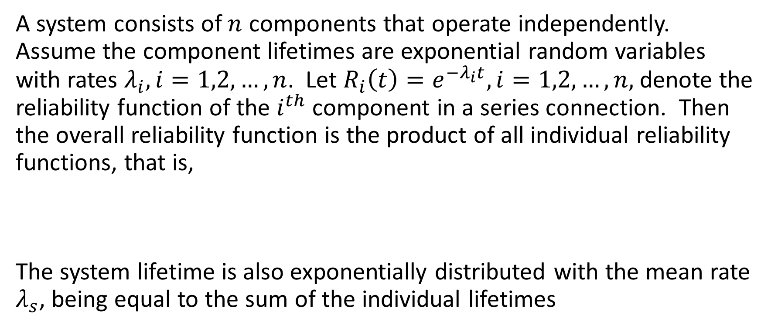
Example 1
A system consists of $n$ components that operate independently. Assume the component lifetimes are exponential random variables with rates $λ_{i}, i=1,2,…,n$. Let $R_{i}\left(t\right)=e^{−λ_{i}t}, i=1,2,…,n,$ denote the reliability function of the $i^{th}$ component in a series connection. Then the overall reliability function is the product of all individual reliability functions, that is,
The system lifetime is also exponentially distributed with the mean rate $λ_{s}$, being equal to the sum of the individual lifetimes

Slide 25
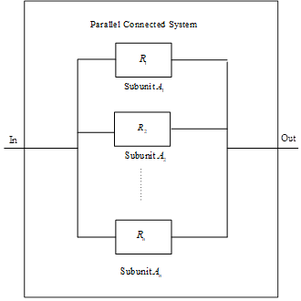
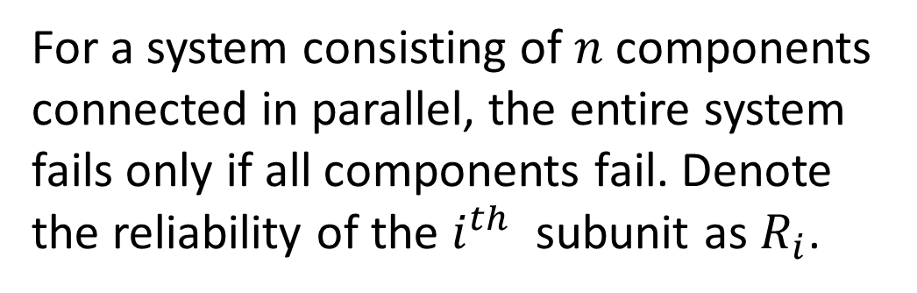
Reliability of Parallel Connected Systems
For a system consisting of $n$components connected in parallel, the entire system fails only if all components fail. Denote the reliability of the $i^{th}$ subunit as $R_{i}$.

Slide 26
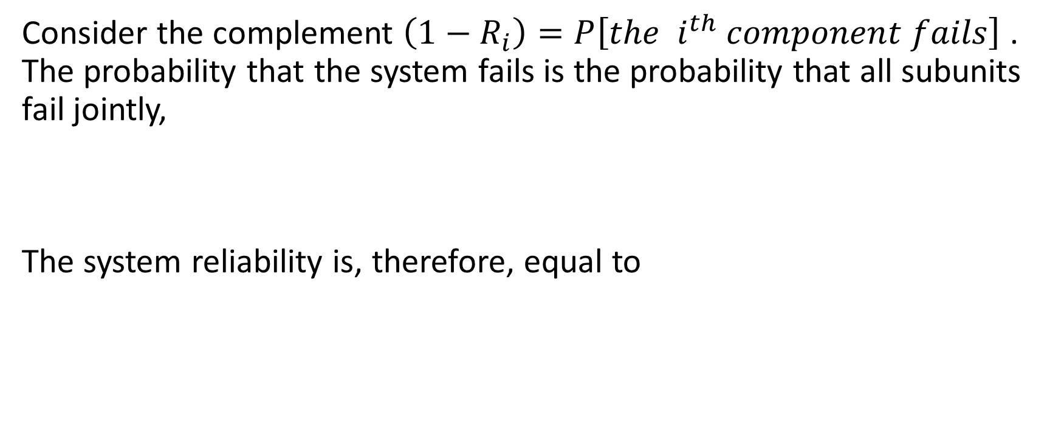
Reliability of Parallel Connected Systems
Consider the complement $\left(1−R_{i}\right)=P\left[the i^{th} component fails\right]$ . The probability that the system fails is the probability that all subunits fail jointly,
The system reliability is, therefore, equal to

Slide 27

Example
A parallel-connected system consists of $n$ components and the component lifetimes are exponential random variables with rates $λ_{i}, i=1,2,…,n$. Find the reliability of the system.

Slide 28
Example 3
In the electrical system shown below, all components work independently. The reliability (probability of working) of each component is also shown in the diagram. Find the probability that
the entire system works and
the component C does not work, given that the entire system works.

Slide 29
Solutions
A, B, and the subsystem C and D constitute a serial circuit system, whereas the subsystem C and D itself is a parallel circuit system.
(a) The probability that the entire system works is

Slide 30
Example 3 Continued
(b) The conditional probability is

Slide 31
Exercise Problems
Problem 1: The diagram of an electrical system is given in the diagram below. What is the probability that the system works? Assume the components fail independently. (answer 0.8037)

Slide 32
Exercise Problems
Problem 2: The diagram of an electrical system is given in the diagram below. Assume the components fail independently.
What is the probability that the entire system works? (answer 0.7511)
Given that the system works, what is the probability that the component A is not working? (answer 0.2045)

